Slide 1

Flaw Detection in Medical Pills Manufacturing using Image Processing and Machine Learning
University of Mhamed BOUGARA Boumerdes
IGEE
Final Year Project
Students:
Zineddine Mohamed Islem Bettouche
Zakarya Louahchi
Supervisor: Dr. CHERIFI D.
14/07/2019

Slide 2
Outline
1. Introduction
2. Pills Manufacturing
-Overview
- Flaws
3. Image Processing as a Detection Tool
-Detection Overview
-Definition
-Image Processing Techniques
-Classic Algorithms
-Machine Learning
4. Implementation
-Real Sample Application
-Trade Offs
-Further Realization
5. Conclusion

Slide 3
1.Introduction
Medical Pills Manufacturing is immense, and eventually flaws occure.
Image Processing can be used to detect these flaws.

Slide 4
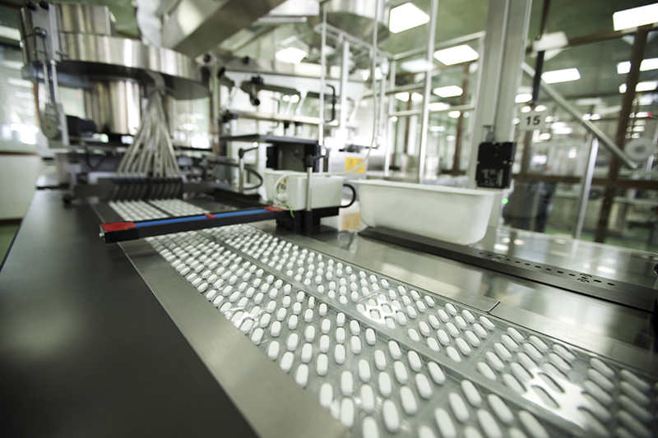
2.1 Overview
2.Pills Manufacturing
Medical Pills Manufactory

Slide 5
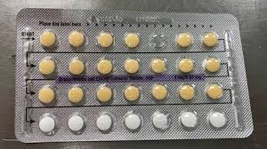
2.2 Flaws
2.Pills Manufacturing
Medical Tablet Missing a Pill

Slide 6

3.1 Detection Overview
3. Image Processing as a Detection Tool
Image Processing Techniques
Pills Count
1. Typical Pills
2. Detection Algorithms
3. Seeking for Missing Pills

Slide 7
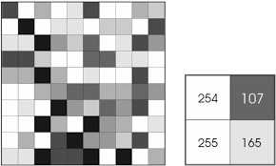
3.2 Definition
3. Image Processing as a Detection Tool
Digital image processing is the use of computer algorithms
to perform image processing on digital images.

Slide 8

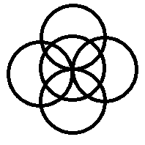

3.3 Image Processing Techniques
3. Image Processing as a Detection Tool
Classic Algorithms
Machine Learning
Blob Detection
Circle Hough Transform
Haar Cascade Classifier

Slide 9
3.4 Classics Algorithms
3. Image Processing as a Detection Tool
Input Image
Gray Scale
Median Blur
Canny Edge Detection
Blob Detection
Circle Hough Transform

Slide 10
3.5 Machine Learning in Image Processing
3. Image Processing as a Detection Tool
A. Learning Process
Images containing pills
Known Positives
Model
Trained Model
Known negatives
Haar Cascade Classifier
Trained Haar Cascade Classifier
Images not containing pills

Slide 11
3.5 Machine Learning in Image Processing
3. Image Processing as a Detection Tool
B. Detection Process
New Target
Trained Model
Positives
New image
Trained Haar Cascade Classifier
Circulating over pills

Slide 12

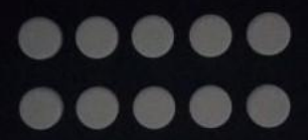

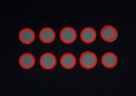
4.1 Real Sample Application
4. Implementation
Output
Circle Hough Transform
Blob Detection
Input image (typical pills)
Haar Cascade Classifier

Slide 13
4.2 Speed-Accuracy Trade-offs
4. Implementation
 | Classic Algorithms | Machine Learning
Speed | Very Fast | Slower
Accuracy | Less Accurate | Most Accurate
Due to computers high speed, the execution time difference is negligible between approaches.
If only one algorithm is to be chosen, it would be Machine Learning.

Slide 14
4.3 Critical Cases
4. Implementation
Altough Blob Detection is accuate when it comes to detecting various shapes, it must be always reset to detect a new shape. And it is too dependent on lighting and blobs’ size.
If a pill is not perfectly circular, Circle Hough Transform fails to detect it.
Therefore, Machine Learning is more practicle due to its flexibility.

Slide 15

4.3 Interface
4. Implementation
Implementation can be gathered in a user-friendly application
This allows for a better real-time usage
PyQt

Slide 16
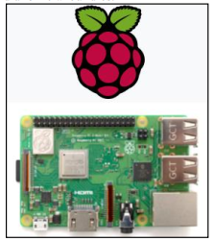
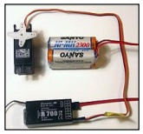
4.4 Further Realization
4. Implementation
Processing
Elimination
Servomotor
Raspberry Pi

Slide 17
Conclusion
This Project combined image processing, machine learning, and software development
Machine learning approaches are more accurate when models are trained appropriately
Image processing and machine learning can modulate proper solutions for industrial problems

Slide 18
Thank You!

